Slide 1



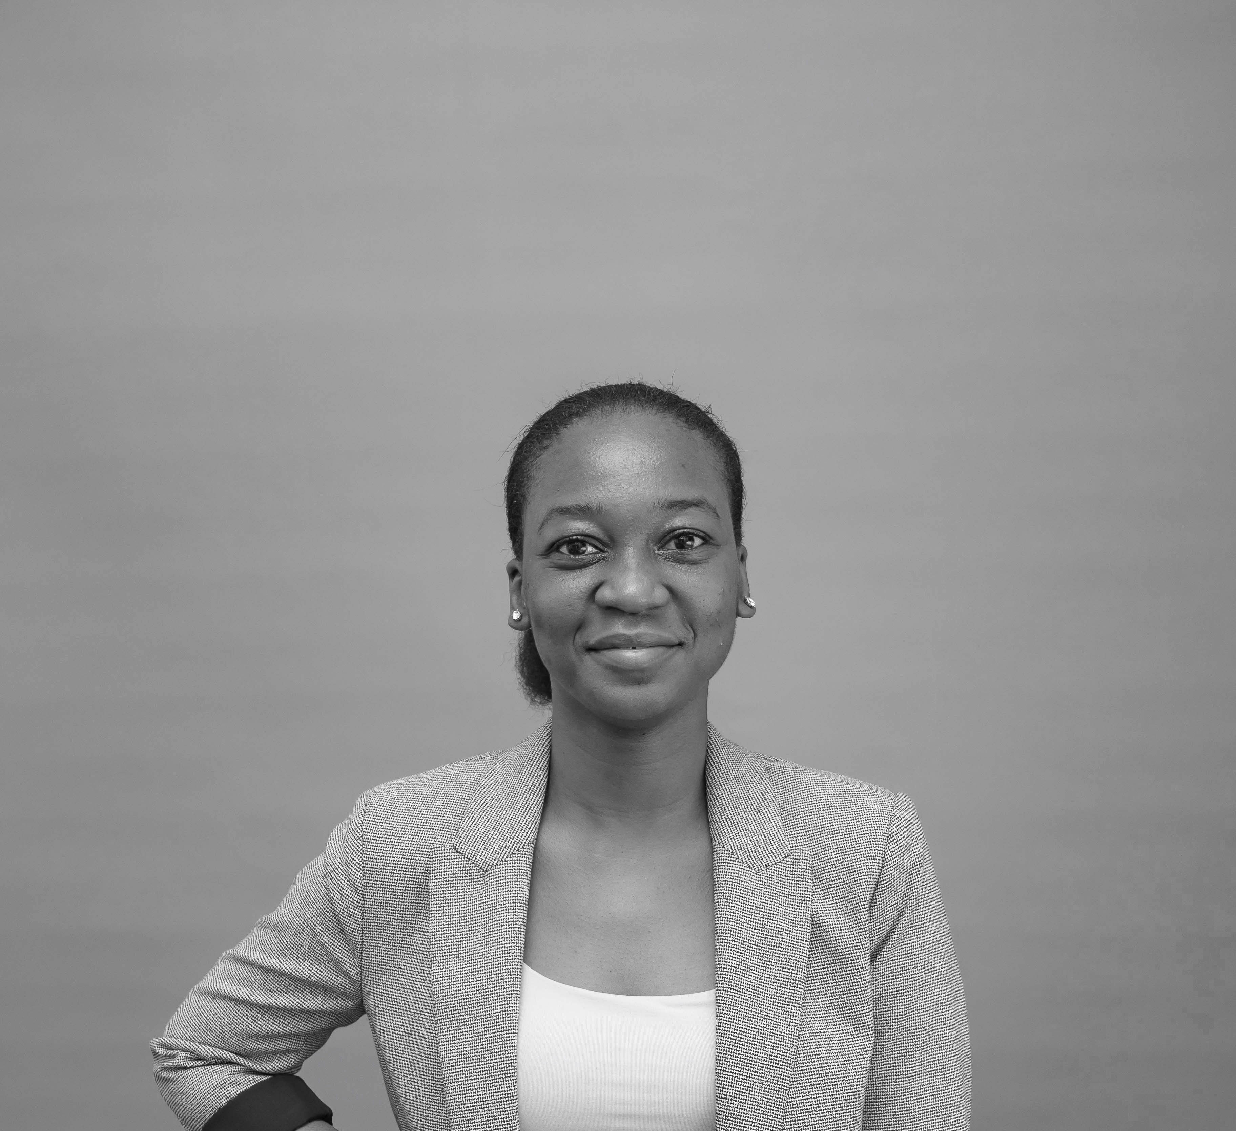
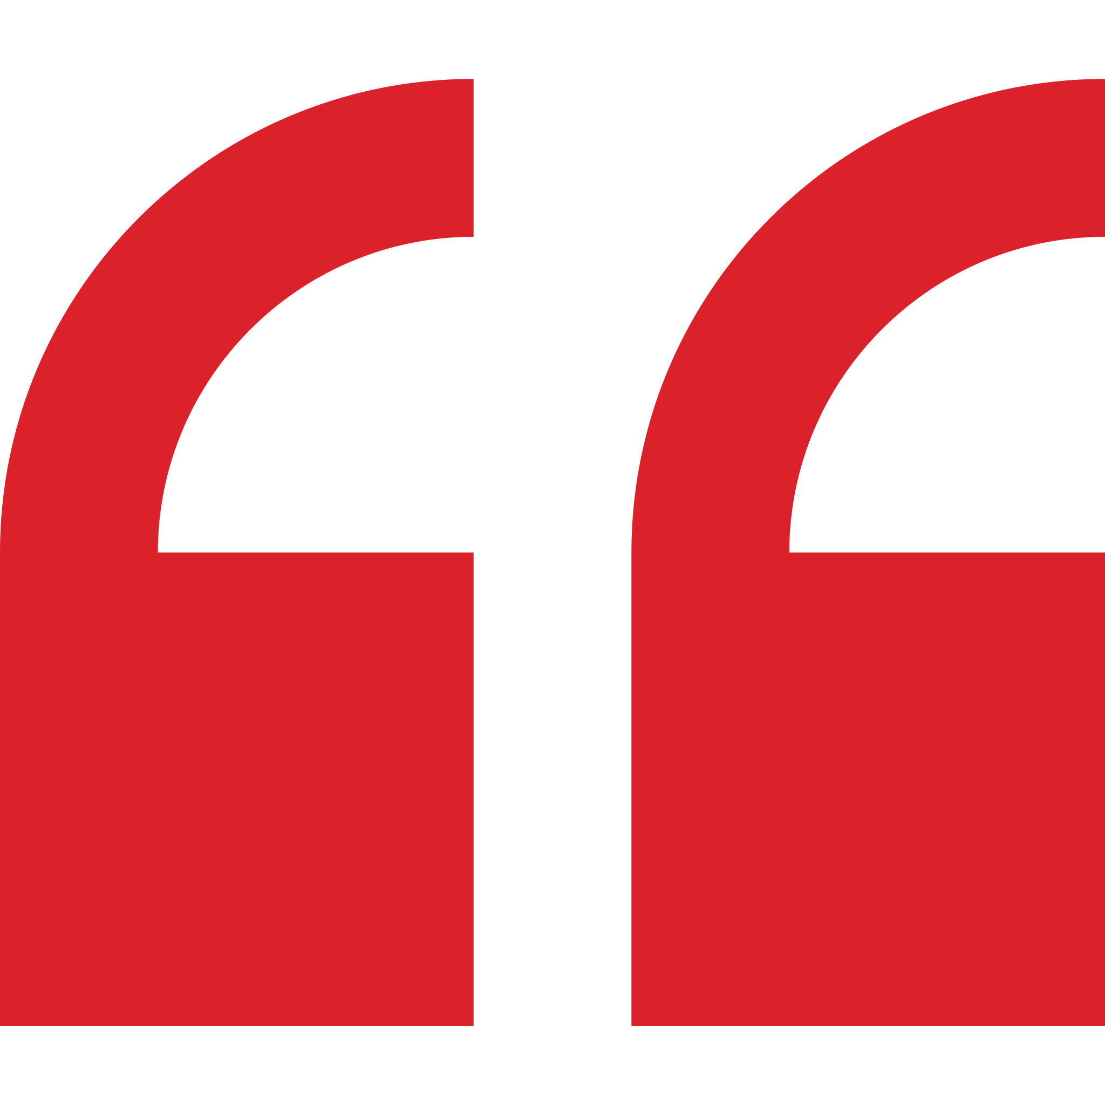
Aishatu Abdullahi – Associate
Professional experience
Education and skills
Africa Foresight Group
Developed a white paper on Nigerian infrastructure investment
Conducted a due diligence on a private educational institution in Nigeria
2 years as a process engineer at a multinational biotechnology company in the United States. Aishatu‘s experience includes:
Overseeing the commissioning of a $2.6 million compliance project, enhancing process efficiency by over 50% and increasing capacity by 15%.
Developing project lifecycle management system to identify countermeasures and containments for critical project issues, in order to keep projects within scope, budget and deadlines
Identifying and implementing LEAN transformation projects to increase capacity and reduce operating costs
Serving as project lead and technical expert in new process and product development for global launches with Bayer
Aishatu holds an MS in Petroleum Engineering from the University of Pittsburgh; she researched the corporate social responsibility of oil and gas companies in Nigeria and the Philippines
She holds a BSc degree in Chemical Engineering and a BA in Chemistry from Virginia Tech in the U.S.
Aishatu is fluent in English and Hausa; proficient in French
Introduction
Aishatu Abdullahi is a past engineering professional with a strong business acumen. Aishatu grew up in four different continents and her vision for Africa’s economic prosperity has brought her home to contribute to the growth of African companies.
I am committed to engineering creative and sustainable solutions for our clients.

